Slide 1
Introduction to Data Science

Slide 2
Introduction to Pandas Package

Slide 3
What is Pandas?
Pandas is a popular Python package for data science. It offers powerful, expressive, and flexible data structures that make data cleaning and analysis fast and easy in Python. Pandas is an open source data analysis and manipulation tool that is often used in tandem with numerical computing tools like NumPy and SciPy, analytical libraries like statsmodels and scikit-learn, and data visualization libraries like matplotlib and Seaborn. You can think of Pandas as an extremely powerful version of a spreadsheet like Microsoft Excel, with more features.

Slide 4
How to install Pandas?
If you installed the Anaconda distribution of Python - it includes Python, NumPy, Pandas, and other commonly used packages for scientific computing and data science. Therefore, no further installation steps are necessary. We recommend you use the Anaconda distribution of Python as you begin your data science journey.

Slide 5
Importing the Pandas module
To import pandas, we usually import it with its alias, pd.
import pandas as pd

Slide 6
Core components of Pandas
The two primary components of pandas are the Series and DataFrame. A Series is essentially a column, and a DataFrame is a multi-dimensional table made up of a collection of Series.

Slide 7
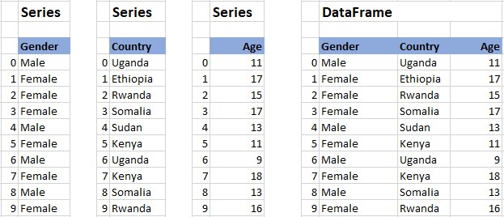
Core components of Pandas
A Series is a column and a DataFrame is a collection of Series.

Slide 8

Lab session

